Slide 1
Interpretation of Brain Imaging Data using Python programming
Presented By-
Akshaya Srinidhi V 119011002
Keerthi Anand R 119011013
Dhanushya Sree R119010015

Slide 2
fMRI
Functional magnetic resonance imaging
Measures brain activity by detecting changes associated with blood flow
Cerebral blood flow and neuronal activation are coupled
The primary form of fMRI uses the blood-oxygen-level dependent (BOLD) contrast
The resulting brain activation can be graphically represented by color-coding the strength of activation across the brain or the specific region studied

Slide 3
Structural MRI -visualize, locate anatomical structures within the brain in great detail.
fMRI experiments - identify active regions in the brain during specific tasks are typically combined with structural MRI scans.
Although structural MRI images – also represent volume information(voxels),
Brain - scanned in several planes or slices during a MRI

Slide 4
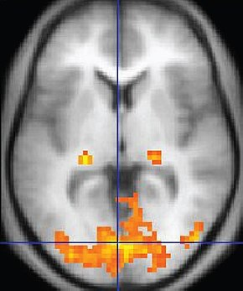
An fMRI image with yellow areas showing increased activity compared with a control condition
BOLD responses from activity due to tasks/stimuli, includes also resting state fMRI, or taskless fMRI

Slide 5
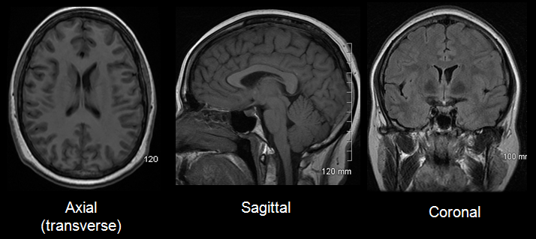
Anatomical planes

Slide 6
RESOLUTION
SPACIAL:
Spatial resolution of an fMRI study refers to how well it discriminates between nearby locations.
It is measured by the size of voxels, as in MRI.
A voxel is a three-dimensional rectangular cuboid, whose dimensions are set by the slice thickness, the area of a slice, and the grid imposed on the slice by the scanning process
TEMPORAL:
Temporal resolution is the smallest time period of neural activity reliably separated out by fMRI

Slide 7
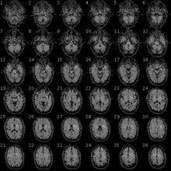
CLINICAL USE
Physicians use fMRI to assess how risky brain surgery or similar invasive treatment is for a patient and to learn how a normal, diseased or injured brain is functioning.

Slide 8
PROJECT DETAILS-PSEUDO CODE
Get the data in the which from the file.
Create objects in class planes
coronal ,transversal, sagittal, x_size, y_size, n_slice, n_volume
Using file_data function to get the data.
Using display_image function, display the images acquired.
Using reshape_data function, reshape the fMRI images to remove noise.
Use organize_data function to reorganize the data and get the required information for statistical analysis.
Use plot_data function to convert the images to signal and plot the voxel time course.

Slide 9
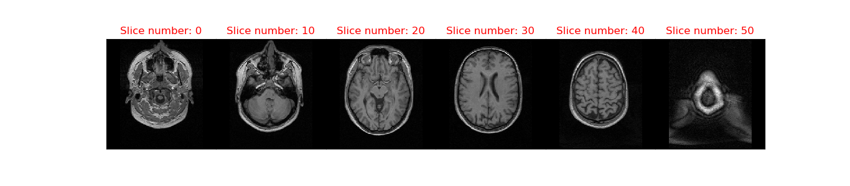
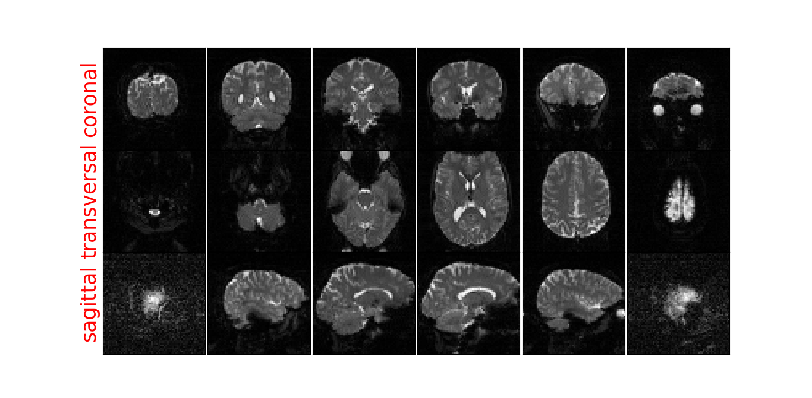
Figure 1
Figure 2

Slide 10
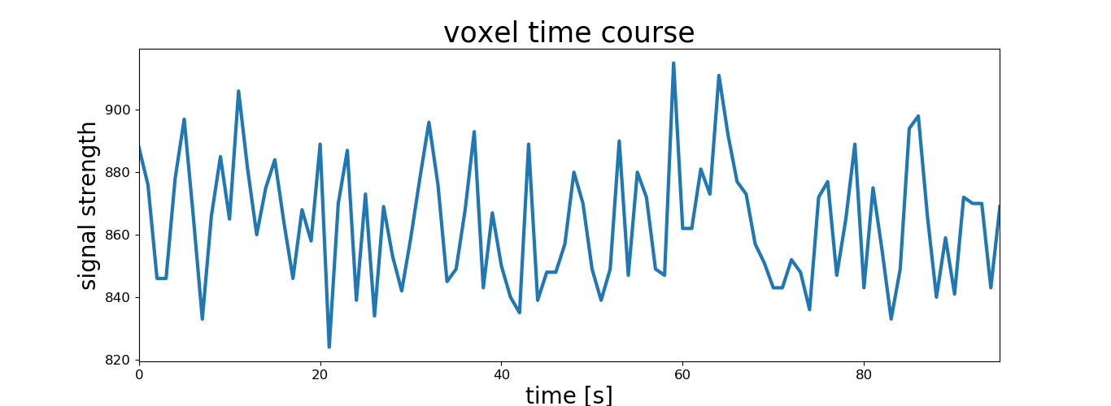
Figure 3

